Slide 1
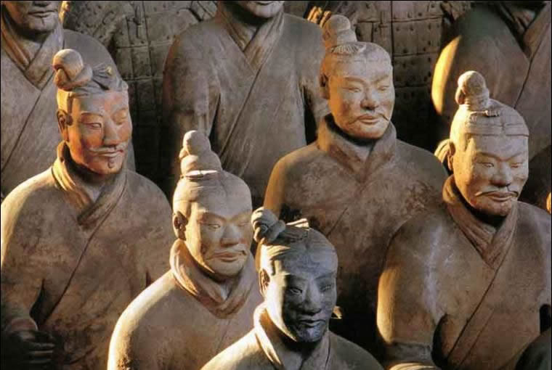
Chinese Discoveries

Slide 2
Discovery Menu
Manufacturing Paper
Compass Tea Gunpowder
Wood Block Printing

Slide 3
Tea
Legend has it that the first person to drink tea was a Chinese man who one day took his wife and children mountain climbing. During the climb he became quite thirsty and while he was feeling thirsty a leaf drifted onto his foot. He picked this leaf up and twisted the leaf with his fingers. The juice of the leaf went on to his fingers and he tasted the juice with his tongue. The taste of the juice was quite bitter, so he felt that this leaf could have medicinal properties and could help quench thirst, when brewed. Thus, according to legend he was the first individual to drink tea.
Map of the
Tea Horse Road

Slide 4
Manufacturing Paper
The Ancient Chinese were the first to invent paper and printing. There were 3 different important kinds of paper, the very first being silk rags. The cheap kinds were no more the wooden strips, and the most expensive was silk cloth. Although most of the kinds of paper was made from over 50%bamboo, some of the other things they were made of were silk, cloth, hemp, mulberry bark, and plant fibers.
These plates were used to print paper money.

Slide 5
Wood Block Printing
In the T'ang dynasty, 618-906 A.D., the first printer was invented.
Wood Block Printing is a technique for printing text, images or patterns used widely throughout East Asia and originating in China in antiquity as a method of printing on textiles and later paper. As a method of printing on cloth, the earliest surviving examples from China date to before 220.

Slide 6
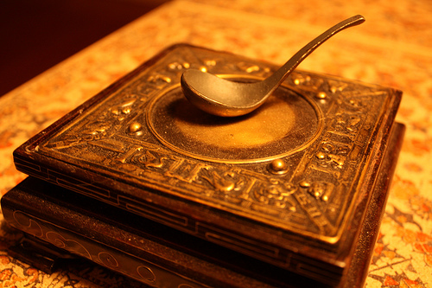
Compass
The compass was for religious use. When new houses were being built, they used it to see if the house was faced in perfect harmony with nature (which meant they thought if you faced your house to magnetic north, you and nature would get along). The compass started out as a wooden circle with markings on it, and a magnetic spoon on top.

Slide 7
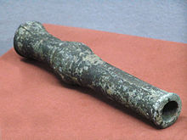
Gunpowder
In the T'ang dynasty gunpowder was accidentally invented in an attempt to make the elixir of life, to make the emperor immortal. A cannon was just a bamboo case holding gunpowder. Bamboo or an iron basket, which was like a smaller version of the cannon, had arrows with rockets attached to them. The arrow rockets would shoot out of the miniature cannon like bullets out of a gun.
This is the earliest known written formula for gunpowder, from the Chinese Wuijing Zongyao of 1044 A.D.

Slide 8
Favorite Sites
China Gunpowder Printing and Compass
http://kaleidoscope.cultural-china.com/en/136Kaleidoscope1.html
China Paper
http://www.crystalinks.com/chinascience.html
China Tea
http://www.2basnob.com/tea-history-timeline.html

Slide 9
California State Standards
Grade Seven
History-Social Science Content Standards.
World History and Geography: Medieval and Early Modern Times
Students in grade seven study the social, cultural, and technological changes that occurred in Europe, Africa, and Asia in the years A. D. 500Ð 1789. After reviewing the ancient world and the ways in which archaeologists and historians uncover the past, students study the history and geography of great civilizations that were developing concurrently throughout the world during medieval and early modern times. They examine the growing economic interaction among civilizations as well as the exchange of ideas, beliefs, technologies, and commodities. They learn about the resulting growth of Enlightenment philosophy and the new examination of the concepts of reason and authority, the natural rights of human beings and the divine right of kings, experimentalism in science, and the dogma of belief. Finally, students assess the political forces let loose by the Enlightenment, particularly the rise of democratic ideas, and they learn about the continuing influence of these ideas in the world today.
7.3 Students analyze the geographic, political, economic, religious, and social structures of the civilizations of China in the Middle Ages.
5. Trace the historic influence of such discoveries as tea, the manufacture of paper, wood-block printing, the compass, and gunpowder.
Web Site http://www.cde.ca.gov/be/st/ss/

Slide 10
References
2basnob: A history of tea timeline (n.d.). Retrieved August 10, 2010, from http://www.2basnob.com/tea-history-timeline.html.
Age of the sage: Transmitting the wisdom of the ages (n.d.). Retrieved August 10, 2010, from http://www.age-of-the-sage.org/archaeology/terracotta_warriors.html.
China's science and technology (n.d.). Retrieved August 10, 2010, from http://www.crystalinks.com/chinascience.html.
Early printing traditions in China. (n.d.). Retrieved August 10, 2010, from http://www.asiapacificculturalcenter.org/index.php?option=com_content&view=article&id=158&Itemid=71.
Four great inventions of ancient China (2010, July 7). Retrieved August 10, 2010, from http://en.wikipedia.org/wiki/Four_Great_Inventions_of_ancient_China.
History of Chinese inventions - inventions of the magnetic compass (n.d.). Retrieved August 10, 2010, from http://www.computersmiths.com/chineseinvention/compass.htm.
Standards and frameworks. (n.d.). Retrieved August 10, 2010, from http://www.cde.ca.gov/be/st/.
Tea and Compass from http://images.search.yahoo.com.

